Slide 1
Concurrency Control
Chitkara University, Himachal Praesh

Slide 2
Concurrency Control
Introduction
The term concurrency refers to the fact that DBMS typically allow many transactions to access the database at the same time.
Concurrency control is the procedure in DBMS for managing simultaneous operations without conflicting with each another.
Some kind of control mechanism is needed to ensure the concurrent transaction do not interface with each other.

Slide 3
Concurrency Control contd…
Introduction
Concurrent access is quite easy if all users are just reading data.
There is no way they can interfere with one another.
Though for any practical database, would have a mix of reading and WRITE operations and hence the concurrency is a challenge.
This control is achieved through concurrency control schemes.

Slide 4
Why use Concurrency method?
Reasons for using Concurrency control method is DBMS:
To apply Isolation through mutual exclusion between conflicting transactions
To resolve read-write and write-write conflict issues
To preserve database consistency through constantly preserving execution obstructions
The system needs to control the interaction among the concurrent transactions. This control is achieved using concurrent-control schemes.
Concurrency control helps to ensure serializability

Slide 5
Potential Problems of Concurrency
Three Concurrency Problems
Lost Updates Problem : It occur when multiple transactions access and update the same data item
Uncommitted Dependency Problem : Uncommitted dependency issues occur when one transaction is allowed to retrieve (dirty read) or update the tuple that has been updated by another transaction but not yet committed.
Inconsistency Problem : It occurs when one transaction takes summary over the value of all the instances of a repeated data-item, and second transaction update few instances of that specific data-item. In that situation, the resulting summary does not reflect a correct result.

Slide 6
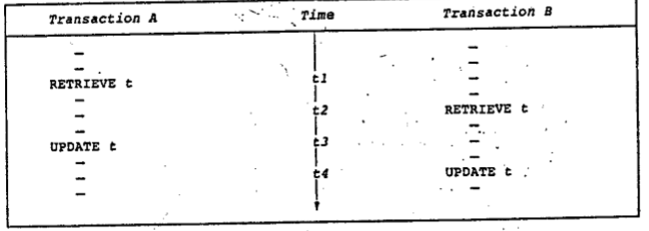
Lost Update Problem It occur when multiple transactions access and update the same data item
Consider the situation illustrated in Fig. 1.
Two Transactions : A & B
Reading and writing the tuple t at different instance of time
Fig. 1: Transaction A lose an update at time t4

Slide 7
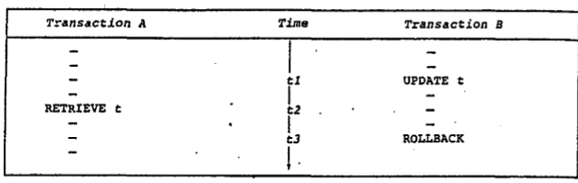
The uncommitted Dependency Problem :
Uncommitted dependency issues occur when one transaction is allowed to retrieve (dirty read) or update the tuple that has been updated by another transaction but not yet committed.
Fig. 2: Transaction A becomes dependent on an uncommitted change at time t2

Slide 8
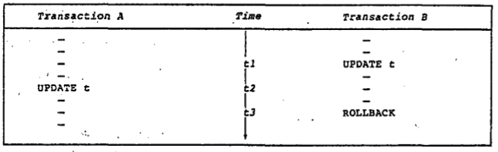
The uncommitted Dependency Problem contd…
Fig. 3: Transaction A updates an uncommitted update at time t2 and lose that update at time t3

Slide 9
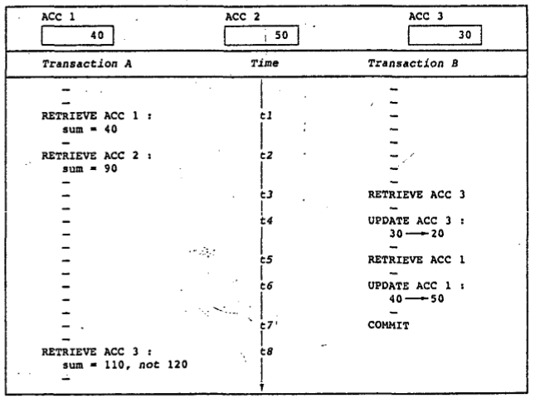
The inconsistency Analysis Problem
The Fig. 3: illustrate two Transactions A and B.
Transaction A is summing Account balances
Transaction B is transferring an amount 10 from Account 3 to Account 1.
Result : The result produced by Transaction A, 110 is incorrect.

Slide 10
Lock-Based Protocols
A lock is a mechanism to control concurrent access to a data item
Data items can be locked in two modes :
1. exclusive (X) mode. Data item can be both read as well as
written. X-lock is requested using lock-X instruction.
2. shared (S) mode. Data item can only be read. S-lock is
requested using lock-S instruction.
Lock requests are made to concurrency-control manager. Transaction can proceed only after request is granted.

Slide 11
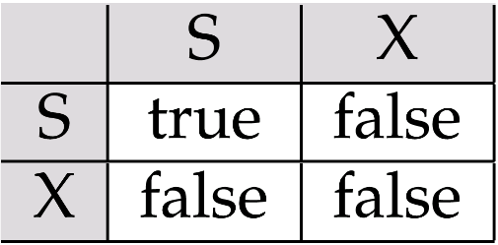
Lock-Based Protocols Contd...
A transaction may be granted a lock on an item if the requested lock is compatible with locks already held on the item by other transactions.
Any number of transactions can hold shared locks on an item, but if any transaction holds an exclusive on the item no other transaction may hold any lock on the item.
If a lock cannot be granted, the requesting transaction is made to wait till all incompatible locks held by other transactions have been released. The lock is then granted.
Lock-compatibility matrix

Slide 12
Lock-Based Protocols Contd…
Example of a transaction performing locking:
Issues/ Rules : ---
Locking as above is not sufficient to guarantee serializability — if A and B get updated in-between the read of A and B, the displayed sum would be wrong.
A locking protocol is a set of rules followed by all transactions while requesting and releasing locks. Locking protocols restrict the set of possible schedules.
Transaction –T | Transaction –T with Locks
Read(A); Read(B); Display(A+B); | lock-S(A); read (A); unlock(A); lock-S(B); Read(B); Unlock(B); Display(A+B);

Slide 13
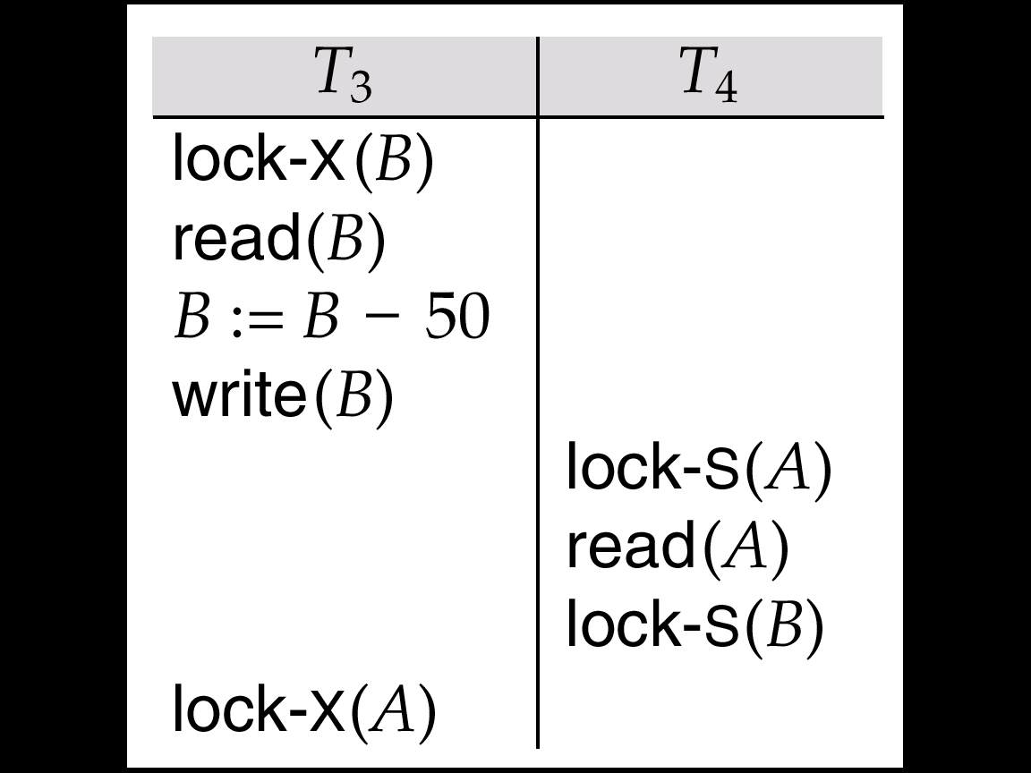
Pitfalls of Lock-Based Protocols
Consider the partial schedule
Neither T₃ nor T₄ can make progress — executing lock-S(B) causes T₄ to wait for T₃ to release its lock on B, while executing lock-X(A) causes T₃ to wait for T₄ to release its lock on A.
Such a situation is called a deadlock.
To handle a deadlock one of T₃ or T₄ must be rolled back and its locks released.

Slide 14
Pitfalls of Lock-Based Protocols Contd...
The potential for deadlock exists in most locking protocols. Deadlocks are a necessary evil.
Starvation is also possible if concurrency control manager is badly designed. For example:
A transaction may be waiting for an X-lock on an item, while a sequence of other transactions request and are granted an S-lock on the same item.
The same transaction is repeatedly rolled back due to deadlocks.
Concurrency control manager can be designed to prevent starvation.

Slide 15
The Two-Phase Locking Protocol
This is a protocol which ensures conflict-serializable schedules.
Phase 1: Growing Phase
transaction may obtain locks
transaction may not release locks
Phase 2: Shrinking Phase
transaction may release locks
transaction may not obtain locks
The protocol assures serializability. It can be proved that the transactions can be serialized in the order of their lock points (i.e. the point where a transaction acquired its final lock).

Slide 16
The Two-Phase Locking Protocol Contd...
Two-phase locking does not ensure freedom from deadlocks
Cascading roll-back is possible under two-phase locking. To avoid this, follow a modified protocol called strict two-phase locking. Here a transaction must hold all its exclusive locks till it commits/aborts.
Rigorous two-phase locking is even stricter: here all locks are held till commit/abort. In this protocol transactions can be serialized in the order in which they commit.

Slide 17
The Two-Phase Locking Protocol Contd…
There can be conflict serializable schedules that cannot be obtained if two-phase locking is used.
However, in the absence of extra information (e.g., ordering of access to data), two-phase locking is needed for conflict serializability in the following sense:
Given a transaction T_{i} that does not follow two-phase locking, we can find a transaction T_{j} that uses two-phase locking, and a schedule for T_{i} and T_{j} that is not conflict serializable.

Slide 18
2PL protocols
Static
Dynamic
Strict

Slide 19
Thanks !

